Slide 1
Session – 9
Agile

Slide 2
What is “Agility”?
Agile Development
Effective (rapid and adaptive) response to change
Effective communication among all stakeholders
Drawing the customer onto the team
Organizing a team so that it is in control of the work performed
Yielding …
Rapid, incremental delivery of software

Slide 3
Agile Development
Agile development methods apply time boxed iterative and evolutionary development, adaptive planning, promote evolutionary delivery, and include other values and practices that encourage agility.

Slide 4
An Agile Process
Is driven by customer descriptions of what is required (scenarios)
Recognizes that plans are short-lived
Develops software iteratively with a heavy emphasis on construction activities
Delivers multiple ‘software increments’
Adapts as changes occur

Slide 5
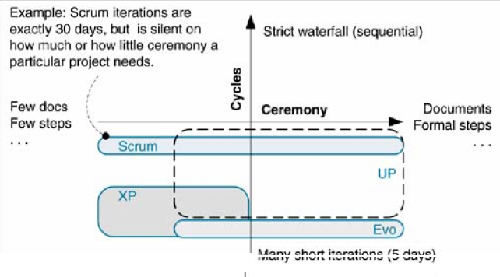
Classification Methods

Slide 6
The Manifesto for
Agile Software Development
“We are uncovering better ways of developing software by doing it and helping others do it. Through this work we have come to value:
  Individuals and interactions over processes and tools
  Working software over comprehensive documentation
  Customer collaboration over contract negotiation
  Responding to change over following a plan
That is, while there is value in the items on the right, we value the items on the left more.”

Slide 7

Agility and the Cost of Change

Slide 8
Agility Principles - I
1. Our highest priority is to satisfy the customer through early and continuous delivery of valuable software.
2. Welcome changing requirements, even late in development. Agile processes harness change for the customer's competitive advantage.
3. Deliver working software frequently, from a couple of weeks to a couple of months, with a preference to the shorter timescale.
4. Business people and developers must work together daily throughout the project.
5. Build projects around motivated individuals. Give them the environment and support they need, and trust them to get the job done.
6. The most efficient and effective method of conveying information to and within a development team is face–to–face conversation.

Slide 9
Agility Principles - II
7. Working software is the primary measure of progress.
8. Agile processes promote sustainable development. The sponsors, developers, and users should be able to maintain a constant pace indefinitely.
9. Continuous attention to technical excellence and good design enhances agility.
10. Simplicity – the art of maximizing the amount of work not done – is essential.
11. The best architectures, requirements, and designs emerge from self–organizing teams.
12. At regular intervals, the team reflects on how to become more effective, then tunes and adjusts its behavior accordingly.

Slide 10
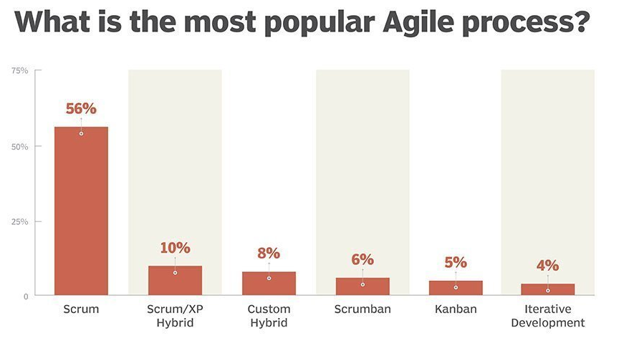
Agile Project Management
Agile Project Management (APM) is an iterative approach to planning and guiding project processes.

Slide 11
Agile Project Management
Jim Highsmith, an Agile Alliance founder and creator of the Adaptive Software Development method, summarizes nine principles for the agile project manager [Highsmith02]:
Deliver something useful to the client; check what they value.
Cultivate committed stakeholders.
Employ a leadership-collaboration style.
Build competent, collaborative teams.
Enable team decision making.
Use short time boxed iterations to quickly deliver features.
Encourage adaptability.
Champion technical excellence.
Focus on delivery activities, not process-compliance activities.

Slide 12
Questions
Define Agility? Explain Agile process.
Explain Classification of methods in agile development.
List out Agile principles.
Illustrate the agile manifesto.
explain agile project management with help of Safe Home application

